Slide 1
ME759 High Performance Computing for Applications in Engineering [Spring 2020]
Lecture 10
02/12/2019
Dan Negrut, 2020 ME759 UW-Madison

Slide 2
Quote of the day
“Weaseling out of things is important to learn. It's what separates us from the animals... except the weasel.”
-- Homer Simpson, Safety Inspector [1989 - ]. Regarding his son upbringing.

Slide 3
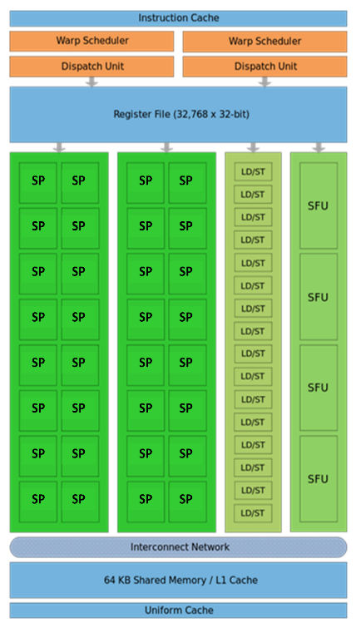
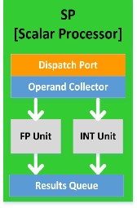
Before we get going…
Last time: The basics of GPU computing
The unit of scaling in GPU computing is the SM (see pic, for Fermi)
Not a lot of CU brain, but lots of ALU muscle
GPU computing happens through kernel execution
A collection of threads executes the kernel
Each thread executes the same kernel
Execution configuration: how many threads execute your kernel
GPU kernel execution is asynchronous
One program calls the GPU to execute kernelFOO, then later on kernelBAR, then later yet kernelWrapUp, etc.
Today
More on execution configuration
GPU “scheduling for execution” issues
Other tidbits:
Dan leaving town: today lecture short & no lecture on Friday
Assignment due on Th at 9 pm
Tonight on-line office hours: Lijing will be in charge
Anonymous feedback: https://forms.gle/ZUCbyKX87mJvK61M7

Slide 4
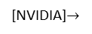
Block and Thread Index (Idx)
Threads and blocks have indices
Used by each thread the decide what data to work on (more later)
Block Index: a triplet of uint
Thread Index: a triplet of uint
Why this 3D layout?
Simplifies memory addressing when processing multidimensional data
Handling matrices
Solving PDEs on 3D subdomains
…
Device
Grid 1
Block
(0, 0)
Block
(1, 0)
Block
(2, 0)
Block
(0, 1)
Block
(1, 1)
Block
(2, 1)
Block (1, 1)
Thread
(0, 0)
Thread
(1, 0)
Thread
(2, 0)
Thread
(3, 0)
Thread
(4, 0)
Thread
(0, 1)
Thread
(1, 1)
Thread
(2, 1)
Thread
(3, 1)
Thread
(4, 1)
[NVIDIA]$→$
Thread
(0, 2)
Thread
(1, 2)
Thread
(2, 2)
Thread
(3, 2)
Thread
(4, 2)
Notes:
A block is a collection of threads that can cooperate with each other by:
Synchronizing their execution
Efficiently sharing data through a low-latency shared memory
Each thread must know what piece of data it’s working on → must be able to “differentiate” itself from other threads in the same block or in a different block
Exercise:
How was the grid defined here (how many dimensions, how many blocks in each direction)?
How was a block defined?

Slide 5
A Couple of Built-In Variables [Critical in supporting the SIMD parallel computing paradigm]
Each thread can find out the grid and block dimensions and its block index and thread index
This info used to figure out what work the thread needs to do
Each thread when executing a kernel has access to the following read-only built-in variables
threadIdx (uint3) – contains the thread index within a block
blockDim (dim3) – contains the dimension of the block
blockIdx (uint3) – contains the block index within the grid
gridDim (dim3) – contains the dimension of the grid
[ warpSize (uint) – provides warp size, we’ll talk about this later… ]
Notes:
dim3 → unspecified dimensions are initialized to 1 (not zero!)
warpSize → not used directly by CUDA code

Slide 6
Check your understanding
Host
Device
How was the grid defined for this pic?
I.e., how many blocks in X and Y directions?
How was a block defined in this pic?
Grid 1
Kernel 1
Block
(0, 0)
Block
(1, 0)
Block
(2, 0)
Block
(0, 1)
Block
(1, 1)
Block
(2, 1)
Grid 2
Kernel 2
Block (1, 1)
Thread
(0, 0)
Thread
(1, 0)
Thread
(2, 0)
Thread
(3, 0)
Thread
(4, 0)
Thread
(0, 1)
Thread
(1, 1)
Thread
(2, 1)
Thread
(3, 1)
Thread
(4, 1)
Thread
(0, 2)
Thread
(1, 2)
Thread
(2, 2)
Thread
(3, 2)
Thread
(4, 2)
Notes:
The grid of blocks: (3,2)
The block of threads: (5,3)

Slide 7
Matrix Multiplication Example

Slide 8
Simple Example: Matrix Multiplication
A straightforward matrix multiplication example that illustrates the basic features of memory and thread management in CUDA
There’s a HW based on this
Use only global memory (don’t bring shared memory into picture yet)
Matrix will be of small dimension, job can be done using one block of threads
Concentrate on
Thread ID usage
Memory data transfer API between host and device
Notes:
Show the main CUDA API functions at work.

Slide 9
Prelude: on the Matrix Data Structure
The following data structure will come in handy
Purpose: store matrix-related data
Note that the matrix is stored in row-major order in a one dimensional array pointed to by “elements”
// IMPORTANT - Matrices are stored in row-major order:
// M(row, col) = M.elements[row * M.width + col]
typedef struct {
int width;
int height;
float* elements;
} Matrix;

Slide 10
Square Matrix Multiplication Example
Compute P = M * N
The matrices P, M, N are of size WIDTH x WIDTH
Assume WIDTH was defined to be 32
Software Design Decisions:
One thread handles one element of P
Each thread will access all the entries in one row of M and one column of N
2*WIDTH read accesses to global memory
One write access to global memory
N
WIDTH
M
P
WIDTH
WIDTH
WIDTH
Notes:
Dot product of 2 32-long array done 1024 times.
Launch 1024 threads.
NOTES:
from an arithmetic intensity pov, this is as bad as it gets! Each thread brings in a lot of data to calculate only one entry
there is a lot of wasted trips to memory, as neighboring threads will need to bring in the same data over and over from global memory

Slide 11
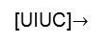
Multiply Using One Thread Block
One Block of threads computes matrix P
Each thread computes one element of P
Each thread does a dot product
Loads a row of matrix M
Loads a column of matrix N
Perform one multiply and addition for each pair of M and N elements
Compute to off-chip memory access ratio close to 1:1
Not that good…
Size of matrix limited by the number of threads allowed in a thread block
Grid 1
N
Block 1
Thread
(2, 2)
48
M
P
width
[UIUC]$→$
Notes:
Low arithmetic intensity! We’ll come back to this (shared memory)

Slide 12
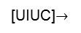
Matrix Multiplication: sequential approach, coded in C
// Matrix multiplication on the (CPU) host in double precision;
void MatrixMulOnHost(const Matrix M, const Matrix N, Matrix P)
{
for (int i = 0; i < M.height; ++i) {
for (int j = 0; j < N.width; ++j) {
double sum = 0;
for (int k = 0; k < M.width; ++k) {
double a = M.elements[i * M.width + k]; //march along a row of M
double b = N.elements[k * N.width + j]; //march along a column of N
sum += a * b;
}
P.elements[i * N.width + j] = sum;
}
}
}
[UIUC]$→$
Notes:
On the CPU, you need 3 loops.
On the GPU, we do not need the 2 outer loops.
Note the stride 1 when reading in a row, but width when reading in a column

Slide 13
Step 1: Matrix Multiplication, Host-side. Main Program Code
int main(void) {
// Allocate and initialize the matrices.
// The last argument in AllocateMatrix: should an initialization with
// random numbers be done? Yes: 1. No: 0 (everything is set to zero)
Matrix M = AllocateMatrix(WIDTH, WIDTH, 1);
Matrix N = AllocateMatrix(WIDTH, WIDTH, 1);
Matrix P = AllocateMatrix(WIDTH, WIDTH, 0);
// M * N on the device
MatrixMulOnDevice(M, N, P);
// Free matrices
FreeMatrix(M);
FreeMatrix(N);
FreeMatrix(P);
return 0;
}
[UIUC]$→$

Slide 14
Step 2: Matrix Multiplication [host-side code]
void MatrixMulOnDevice(const Matrix M, const Matrix N, Matrix P)
{
// Load M and N to the device
Matrix Md = AllocateDeviceMatrix(M);
CopyToDeviceMatrix(Md, M);
Matrix Nd = AllocateDeviceMatrix(N);
CopyToDeviceMatrix(Nd, N);
// Allocate P on the device
Matrix Pd = AllocateDeviceMatrix(P);
// Setup the execution configuration
dim3 dimGrid(1, 1, 1);
dim3 dimBlock(WIDTH, WIDTH);
// Launch the kernel on the device
MatrixMulKernel<<<dimGrid, dimBlock>>>(Md, Nd, Pd);
// Read P from the device
CopyFromDeviceMatrix(P, Pd);
// Free device matrices
FreeDeviceMatrix(Md);
FreeDeviceMatrix(Nd);
FreeDeviceMatrix(Pd);
}
[UIUC]$→$

Slide 15
Step 3: Matrix Multiplication - Device-side Kernel Function
// Matrix multiplication kernel – thread specification
__global__ void MatrixMulKernel(Matrix M, Matrix N, Matrix P) {
// 2D Thread Index; computing P[ty][tx]…
int tx = threadIdx.x;
int ty = threadIdx.y;
// Pvalue will end up storing the value of P[ty][tx].
// That is, P.elements[ty * P. width + tx] = Pvalue
float Pvalue = 0;
for (int k = 0; k < M.width; ++k) {
float Melement = M.elements[ty * M.width + k];
float Nelement = N.elements[k * N. width + tx];
Pvalue += Melement * Nelement;
}
// Write matrix to device memory; each thread one element
P.elements[ty * P. width + tx] = Pvalue;
}
N
WIDTH
M
P
tx
WIDTH
Note: Pvalue is a local value; stored in a register. Access global memory once at the very end
ty
WIDTH
WIDTH
Notes:
Discuss why we have the local variable Pvalue
if we updated directly into the desired entry of P, we would make trips to global memory at each iteration
Pvalue declared here is local (and stored in a register)
we make a single trip to global memory to deposit the aggregate Pvalue
Note: a similar “trick” used in CPU code. There it has to do with not trashing the cache.

Slide 16
Step 4: Some Loose Ends
// Allocate a device matrix of same size as M.
Matrix AllocateDeviceMatrix(const Matrix M) {
Matrix Mdevice = M;
int size = M.width * M.height * sizeof(float);
cudaMalloc((void**)&Mdevice.elements, size);
return Mdevice;
}
// Copy a host matrix to a device matrix.
void CopyToDeviceMatrix(Matrix Mdevice, const Matrix Mhost) {
int size = Mhost.width * Mhost.height * sizeof(float);
cudaMemcpy(Mdevice.elements, Mhost.elements, size, cudaMemcpyHostToDevice);
}
// Copy a device matrix to a host matrix.
void CopyFromDeviceMatrix(Matrix Mhost, const Matrix Mdevice) {
int size = Mdevice.width * Mdevice.height * sizeof(float);
cudaMemcpy(Mhost.elements, Mdevice.elements, size, cudaMemcpyDeviceToHost);
}
// Free a device matrix.
void FreeDeviceMatrix(Matrix M) {
cudaFree(M.elements);
}
void FreeMatrix(Matrix M) {
free(M.elements);
}
[UIUC]$→$
Notes:
QUESTION: why is the 1st argument of cudaMalloc a void**? Must return a pointer
Note: The C malloc returns by return value, not through an argument! So, it can have a signature void *malloc(size_t size)

Slide 17
Before Moving On… [Some Words of Wisdom]
In GPU computing you use as many threads as data items (tasks, jobs) you have to perform
This replaces the purpose in life of the “for” loop
Number of threads & blocks is established at run-time
In many cases, the rule is Number of threads = Number of data items
You’ll have to come up with a rule to match a thread to data item that this thread needs to process
Most common source of errors and frustration in GPU computing
It never fails to deliver (frustration)
:-(
Notes:
RECALL: make sure you do not access outside of bounds.
Always, check the thread ID against the data size.
Mapping threads <-> work is a recurring theme in CUDA programming. Important to do it right! Frustrating arithmetic and logic.

Slide 18
CUDA, Another Example (1/2) [Highlighted aspect: a thread figuring out its work order]
Multiply, pairwise, two arrays of 3 million integers
int main(int argc, char* argv[])
{
const int arraySize = 3000000;
int *hA, *hB, *hC;
setupHost(&hA, &hB, &hC, arraySize);
int *dA, *dB, *dC;
setupDevice(&dA, &dB, &dC, arraySize);
cudaMemcpy(dA, hA, sizeof(int) * arraySize, cudaMemcpyHostToDevice);
cudaMemcpy(dB, hB, sizeof(int) * arraySize, cudaMemcpyHostToDevice);
const int threadsPerBlock = 512;
const int blocksPerGrid = (arraySize + threadsPerBlock – 1)/threadsPerBlock;
multiply_ab<<<blocksPerGrid, threadsPerBlock>>>(dA, dB, dC, arraySize);
cudaMemcpy(hC, dC, sizeof(int) * arraySize, cudaMemcpyDeviceToHost);
cleanupHost(hA, hB, hC);
cleanupDevice(dA, dB, dC);
return 0;
}
Notes:
Why do we use:
blocksPerGrid = arraySize/threadsPerBlock + 1 ?
Is this the best way to calculate the blockSize? NO
What happens if we have arraySize = 1024?
How many blocks do we need? 2
How many do we actually configure? 3
Better:
blocksPerGrid = (arraySize + threadsPerBlock – 1) / threadsPerBlock

Slide 19
CUDA, Another Example (2/2)
__global__ void multiply_ab(int* a, int* b, int* c, int size)
{
int whichEntry = threadIdx.x + blockIdx.x * blockDim.x;
if( whichEntry<size )
c[whichEntry] = a[whichEntry] * b[whichEntry];
}
void setupDevice(int** pdA, int** pdB, int** pdC, int arraySize)
{
cudaMalloc((void**) pdA, sizeof(int) * arraySize);
cudaMalloc((void**) pdB, sizeof(int) * arraySize);
cudaMalloc((void**) pdC, sizeof(int) * arraySize);
}
void cleanupDevice(int *dA, int *dB, int *dC)
{
cudaFree(dA);
cudaFree(dB);
cudaFree(dC);
}
Notes:
Kernel: sequence of steps that a thread performs
Discuss the mapping from thread index to task

Slide 20
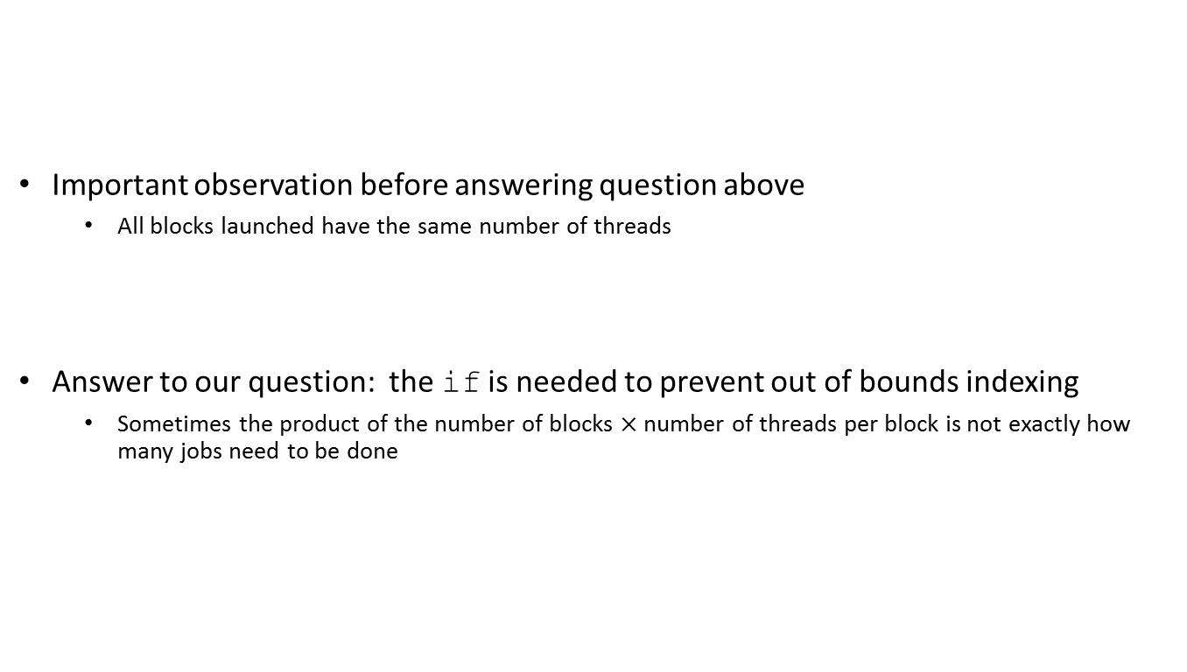
if( whichEntry<size ): Why Do I Need this Test?
Important observation before answering question above
All blocks launched have the same number of threads
Answer to our question: the if is needed to prevent out of bounds indexing
Sometimes the product of the number of blocks $×$ number of threads per block is not exactly how many jobs need to be done

Slide 21
Execution Configuration Related
Assume arrays of 1493 elements (instead of 3000000)
Largest CUDA block that you can get has 1024 threads
Also, 1493 is a prime number
You’ll have to use at least two CUDA blocks of threads
Perhaps you want to use three blocks of 512 each…
You’ll have some threads that do no work (there’ll be an if statement in there)
Problem becomes more interesting in two dimension when you have square blocks to pad a matrix and end up overshooting in two directions

Slide 22
1493 entries in 1D array
You are overshooting here, some threads do no work
Block 0: 512 threads
Block 1: 512 threads
Block 2: 512 threads
1D Example
You are overshooting here
Block 16 by 16
Block 16 by 16
Block 16 by 16
Block 16 by 16
Block 16 by 16
Block 16 by 16
2D Example
Block 16 by 16
Block 16 by 16
Block 16 by 16
Block 16 by 16
Block 16 by 16
Block 16 by 16
You are overshooting here as well

Slide 23
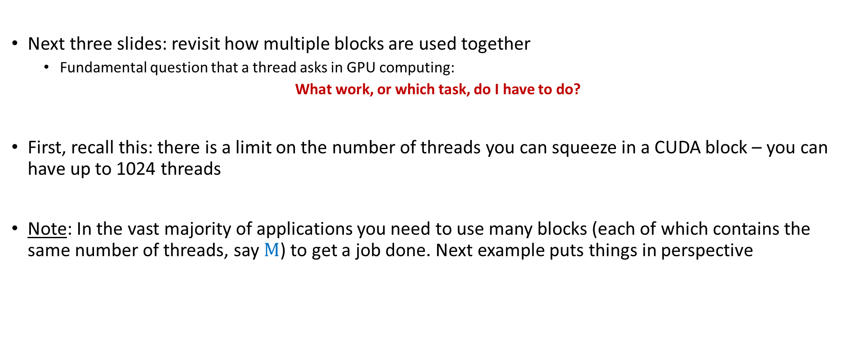
Array Indexing Issues
Next three slides: revisit how multiple blocks are used together
Fundamental question that a thread asks in GPU computing:
What work, or which task, do I have to do?
First, recall this: there is a limit on the number of threads you can squeeze in a CUDA block – you can have up to 1024 threads
Note: In the vast majority of applications you need to use many blocks (each of which contains the same number of threads, say $M$) to get a job done. Next example puts things in perspective

Slide 24
Array Indexing Demo: The multi-block case
[Important to grasp: shows thread-to-task mapping]
Multiple blocks – you will likely be using more than just threadIdx.x
Consider indexing into an 1D array, one thread accessing one element
Assume you have M=8 threads per block and the array is 32 entries long
threadIdx.x
threadIdx.x
threadIdx.x
threadIdx.x
0
1
2
3
4
5
6
7
0
1
2
3
4
5
6
7
0
1
2
3
4
5
6
7
0
1
2
3
4
5
6
7
blockIdx.x = 0
blockIdx.x = 1
blockIdx.x = 2
blockIdx.x = 3
With M threads per 1D CUDA block, the array index that a thread works on is:
int index = threadIdx.x + blockIdx.x * M;
[NVIDIA]→
Notes:
Made up example, where a block can only have 8 threads, but we want to process an array with 32 entries.
0 <= threadIdx.x <= 7
What thread works on entry 21?
Identical to finding offset in 1-dimensional storage of a 2-dimensional matrix:
int index = x + width * y;

Slide 25
Example: Array Indexing
1
2
3
4
5
6
7
8
9
10
11
12
13
14
15
16
17
18
19
20
21
22
23
24
25
26
27
28
29
30
0
31
What is the array index that thread of index 5 in block of index 2 will work on?
M = 8
threadIdx.x = 5
0
1
2
3
4
5
6
7
0
1
2
3
4
5
6
7
0
1
2
3
4
5
6
7
0
1
2
3
4
5
6
7
blockIdx.x = 2
int index = threadIdx.x + blockIdx.x * M;
= 5 + 2 * 8;
= 21;
0
1
2
3
4
5
6
7
8
9
10
11
12
13
14
15
16
17
18
19
20
21
22
23
24
25
26
27
28
29
30
31
[NVIDIA]→
Notes:
In general, the work of a thread is what you would have inside a for loop (but no need for the loop itself)!

Slide 26
Recurring Theme in CUDA Programming [summarizing previous discussion, started after CUDA Example]
Imagine you are one of many threads; you have your thread index & block index
Two things need to be addressed
You need to figure out the work, or the job, you need to take care of
Just like we did on previous slide, where thread 5 in block 2 realized it needed to work on entry 21
You have to make sure you actually need to do that work
In many problems there are threads that need not do any work
Example: you launch 2 blocks with 512 threads; your array is only 1000 elements long; 24 threads at the end might do nothing
“24 threads at the end might do nothing” – depending on the implementation

Slide 27
[short topic]: Timing Your Application
Timing support – part of the CUDA API
You pick it up as soon as you include <cuda.h>
Provides cross-platform compatibility
Deals with the asynchronous nature of the device calls by relying on events and forced synchronization
Reports time in milliseconds, accurate within 0.5 microseconds
From NVIDIA CUDA Library Documentation:
Computes the elapsed time between two events (in milliseconds with a resolution of around 0.5 microseconds). If either event has not been recorded yet, this function returns cudaErrorInvalidValue. If either event has been recorded with a non-zero stream, the result is undefined.

Slide 28
Timing Example: timing a GPU call
#include<iostream>
#include<cuda.h>
int main() {
cudaEvent_t startEvent, stopEvent;
cudaEventCreate(&startEvent);
cudaEventCreate(&stopEvent);
cudaEventRecord(startEvent, 0);
yourKernelCallComesHere<<<NumBlk,NumThrds>>>(args);
cudaEventRecord(stopEvent, 0);
cudaEventSynchronize(stopEvent);
float elapsedTime;
cudaEventElapsedTime(&elapsedTime, startEvent, stopEvent);
std::cout << "Time to get device properties: " << elapsedTime << " ms\n";
cudaEventDestroy(startEvent);
cudaEventDestroy(stopEvent);
return 0;
}
Notes:
RECALL: asynchronous execution on the GPU
You cannot use timing on the host! That would give you garbage.
Need cudaEventSynchronize to wait for that event to complete.
But we only need this for the stopEvent
Indeed, the CUDA operations on the GPU execute in order, so no need to “synchronize” the startEvent

Slide 29
Execution Scheduling Issues
Notes:
Understanding execution scheduling is important for performance (effectively using the hardware).
Knowing the underlying hardware is also important on the CPU (e.g. being aware of caching – as we will see in the OpenMP section). However, the compiler and tool development on the GPU is much more recent and more is left to the developer.

Slide 30
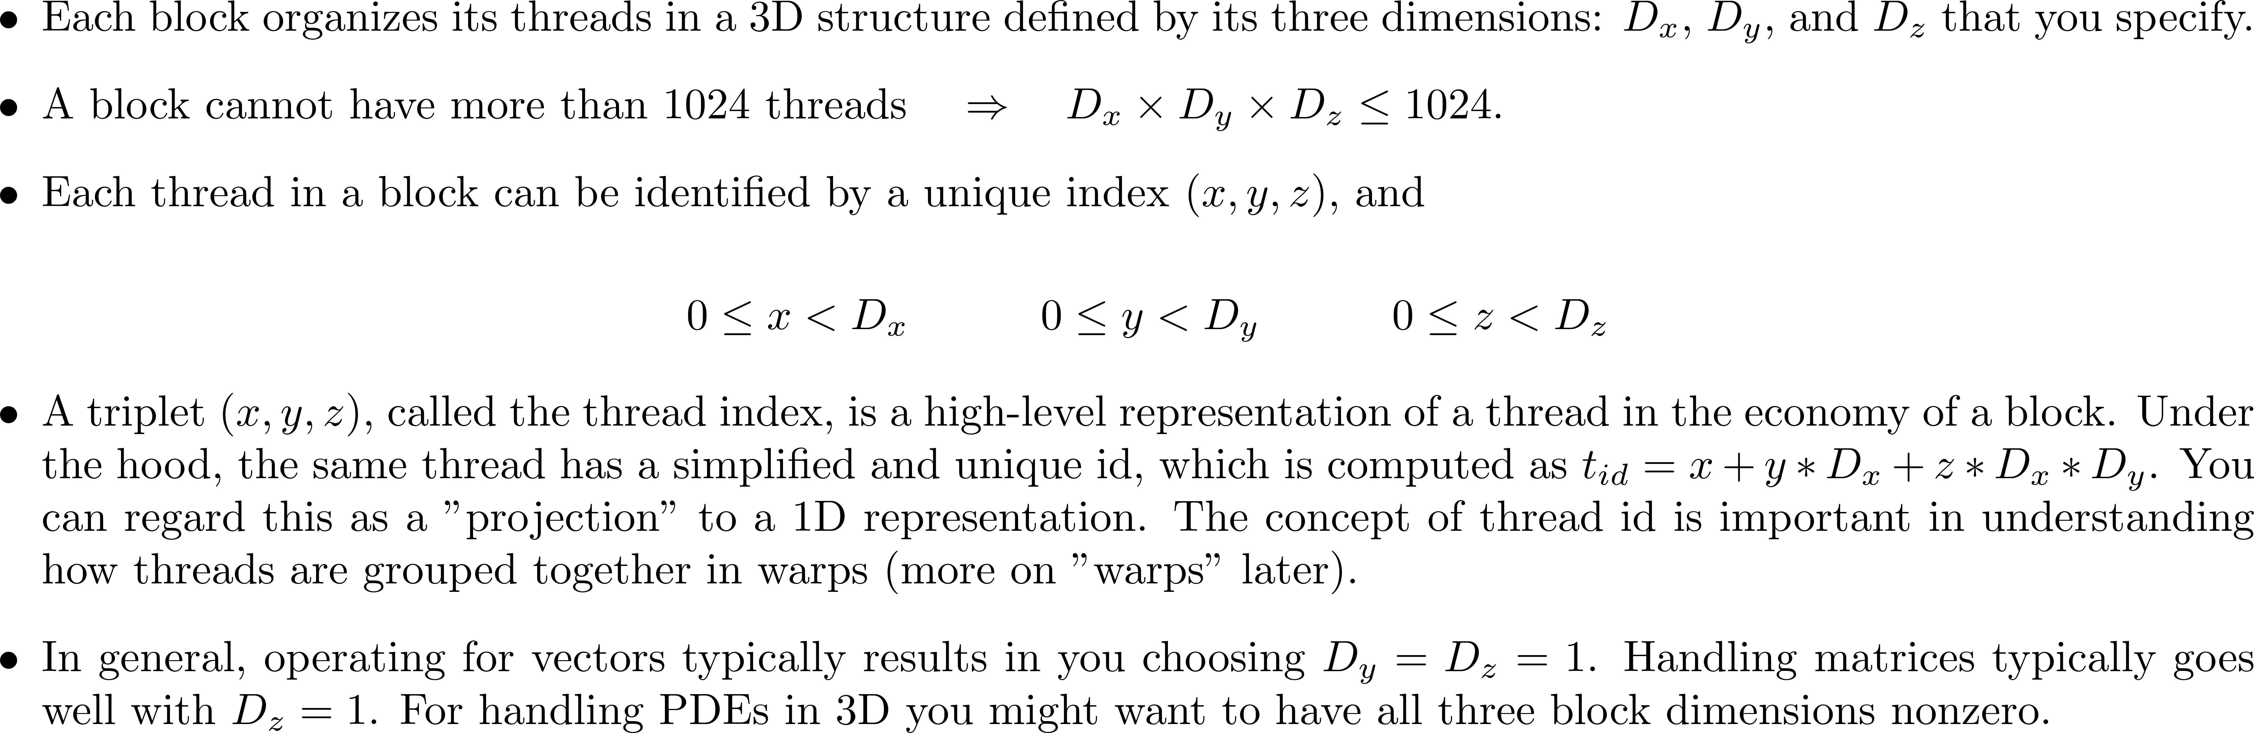
[short/important topic]: Thread Index vs. Thread ID [critical in ($i$) understanding how SIMD is supported in CUDA, and ($ii$) understanding the concept of “warp”]
Notes:
Thread indices are a convenience to the programmer.
The actual threads are organized in a single, linear array of IDs.
This concept also very important in how threads are organized into warps.
Warps are important because the threads in a warp proceed in lock-step fashion (implications to thread divergence, etc.). Warps are the quantum unit of scheduling on an SM.
The index that runs faster is x, next y, slowest z.
For thread with thread index (4,2,3), the next one (for scheduling purposes) is thread with index (5,2,3)! Not (4,2,4)

Slide 31
Thread Execution Scheduling
Starting point observation:
You launch on the device many blocks, each containing many threads
Questions in this segment:
In which order are these blocks executed?
How is this execution process managed?
When/How are the threads in a block executed?
Etc…
Notes:
Two relevant questions...
For larger problems you must launch multiple blocks (because of the 1024 thread/block limit). So how is a kernel split over multiple blocks executed?
For this discussion, recall the mapping between thread index and thread ID. At the end of the day, the SM’s scheduler sees the threads in a block based on their ID (i.e. a one-dimensional array: 0,1,2,…)

Slide 32
High-level Perspective
There are two schedulers at work in GPU computing
A device-level scheduler: assigns blocks to SM that indicate at a given time “excess capacity”
This scheduler called by NVIDIA the “GigaThread engine”
An SM-level scheduler: schedules the execution of the threads in a block onto the SM functional units
This is the more interesting scheduler
Notes:
We’ll talk more about the SM-level scheduler as it is more interesting and important

Slide 33
Device-Level Scheduler
Grid is launched on the device
Thread Blocks are distributed to the SMs
Potentially more than one block per SM
There is a limit on the number of blocks an SM can take.
As Thread Blocks complete kernel execution, resources are freed
Device-level scheduler can launch next block(s) in line
This is the first levels of scheduling:
For running [desirably] a large number of blocks (thousands) on a relatively small number of SMs (60/16/14/etc.)
Limits, for resident blocks/SM:
32 blocks on the Maxwell SM, Pascal SM, and Volta SM
16 blocks can be resident on a Kepler SM
8 blocks can be resident on a Fermi & Tesla SM
Host
Device
Grid 1
Kernel 1
Block
(0, 0)
Block
(1, 0)
Block
(2, 0)
Block
(0, 1)
Block
(1, 1)
Block
(2, 1)
Grid 2
Kernel 2
Block (1, 1)
Thread
(0, 0)
Thread
(1, 0)
Thread
(2, 0)
Thread
(3, 0)
Thread
(4, 0)
Thread
(0, 1)
Thread
(1, 1)
Thread
(2, 1)
Thread
(3, 1)
Thread
(4, 1)
Thread
(0, 2)
Thread
(1, 2)
Thread
(2, 2)
Thread
(3, 2)
Thread
(4, 2)
Notes:
Device-level schedules blocks for execution.
You cannot rely on order of block execution or assignment of blocks over SMs.
You can have 8 (Fermi) or 16 (Kepler) or 32 (recent) blocks resident on an SM

Slide 34
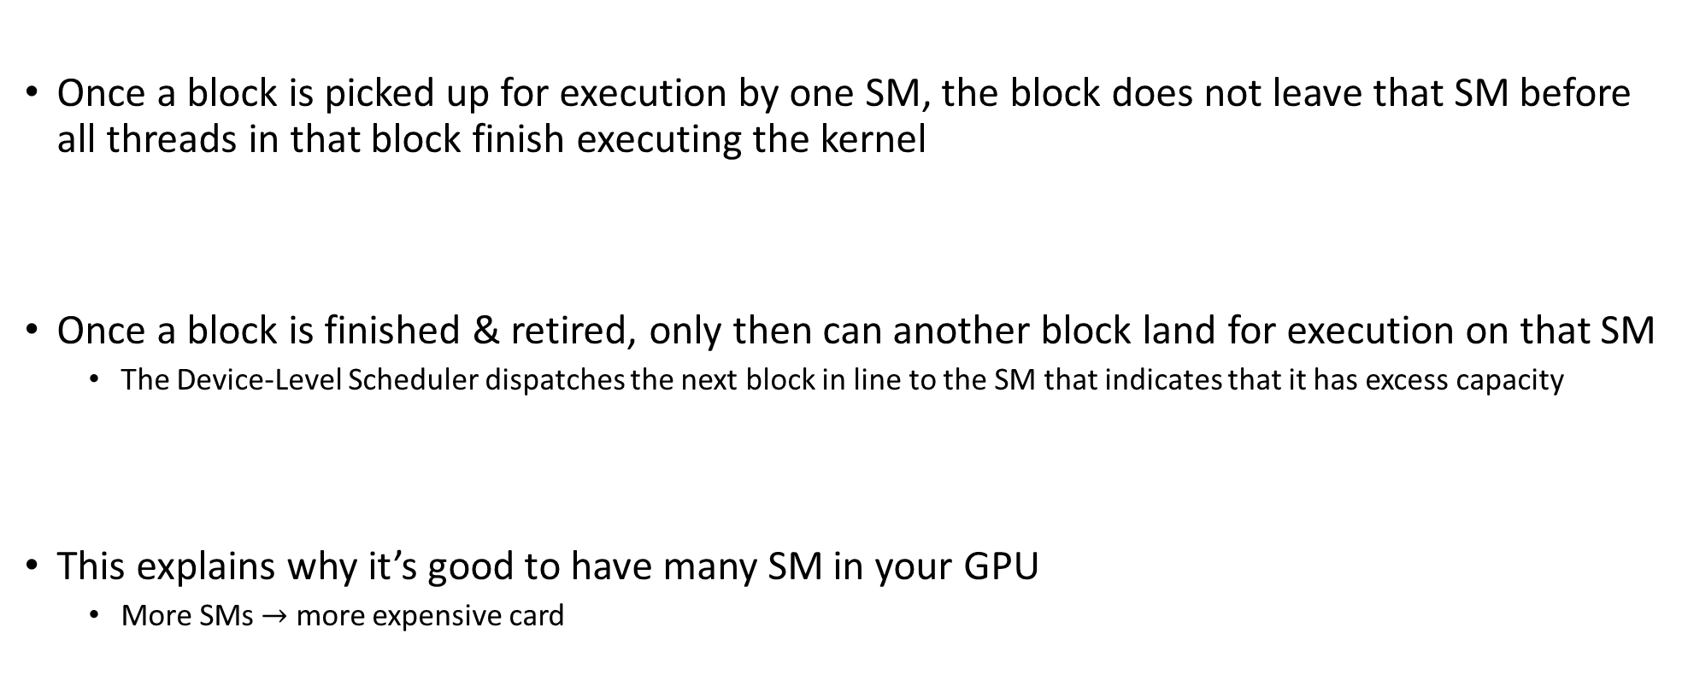
Device-Level Scheduler, Comments
Once a block is picked up for execution by one SM, the block does not leave that SM before all threads in that block finish executing the kernel
Once a block is finished & retired, only then can another block land for execution on that SM
The Device-Level Scheduler dispatches the next block in line to the SM that indicates that it has excess capacity
This explains why it’s good to have many SM in your GPU
More SMs $→$ more expensive card

Slide 35
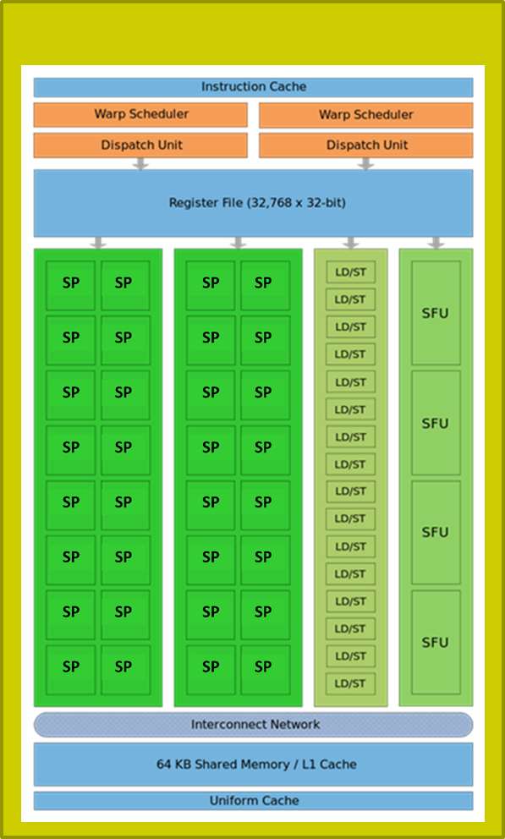
SM-Level Schedulers
…
…
Block 1 Warps
Block 2 Warps
…
…
t0 t1 t2 … t31
t0 t1 t2 … t31
Each block of threads divided in 32-thread warps
“32”: selected by NVIDIA, programmer has no say
Warp: A group of 32 threads of consecutive IDs
Warps are the basic scheduling unit on the SM
Limits, number of resident warps on an SM:
64: on Kepler, Maxwell, Pascal, Volta (i.e., 2048 resident threads)
48: on Fermi (i.e., 1536 resident threads)
32: on Tesla (i.e., 1024 resident threads)
SP
SP
SP
35
Notes:
Assume 2 blocks with 256 threads each.
So you have 512 threads that must be executed on a small number of SPs (32 on Fermi, 64 on Pascal).
How do they get a chance to execution?
The SM has 2 warp schedulers. What gets scheduled for execution on an SM are warps. So we must deal with 16 warps from 2 blocks.
Scheduling is done based on scoreboarding: each warp gets a score based on whether or not they have everything needed to execute (e.g. all operands, required SFU). The schedulers work at ½ the frequency of the SPs.

Slide 36
Quiz
If 3 blocks are processed by an SM and each Block has 256 threads, how many warps are managed by the SM?
Each block of threads is divided into 256/32 = 8 warps
There are 8 * 3 = 24 warps
At any point in time, there are 24 warps that can be selected for execution

Slide 37
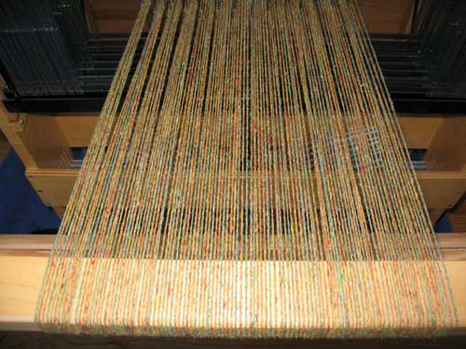
SM Warp Scheduling, more details
SM hardware implements almost zero-overhead Warp scheduling
Warps whose next instruction has its operands ready for consumption are eligible for execution
Eligible Warps are selected for execution on a prioritized scheduling policy
All threads in a Warp execute same instruction
SM multithreaded
Warp scheduler
time
warp 8 instruction 11
warp 1 instruction 42
warp 3 instruction 35
. . .
warp 8 instruction 12
warp 3 instruction 36
Notes:
Low overhead for changing context (unlike CPU)
This is because the context for each thread (e.g. registers) is already available (no need to pack/unpack this with the threads as done on the CPU).
Important to have many warps on an SM: better chance to find one that’s ready to be executed.
Note: on old cards (Tesla) there were only 8 SPs and one scheduler: 4 cycles needed for one instruction (for one warp). Fermi has 2 schedulers and 2x16 SPs that work at twice the frequency of the schedulers → 1 instruction / cycle
This information is important because it can tell you how many warps are needed (for a particular code) to hide memory access latencies with useful computations. In this example: 34 warps minimum.
High arithmetic intensity → fewer warps needed to hide latencies.

Slide 38
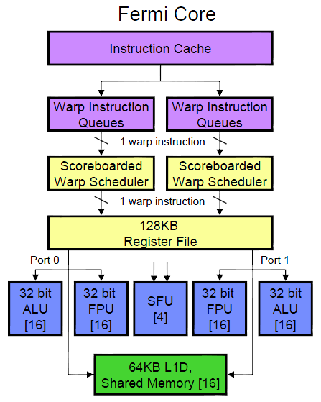
Fermi Specifics
There are two schedulers that issue warps of “ready-to-go” threads
One warp issued at each clock cycle by each scheduler
During no cycle can more than 2 warps be dispatched for execution on the SM’s functional units
Scoreboarding used to figure out which warp is ready
Fermi SM
Notes:
4 function units:
16 ALU/FPU (integer/single precision)
16 ALU/FPU (integer/single precision)
4 SFU (for special mathematical functions)
16 LDST (load/store)
For double precision: both 1 and 2 are used
Scoreboarding looks at:
instructions being fetched/decoded
necessary resources (operands ready? SFU required?)
what instruction modifies what register
Two warps with same score are selected oldest-first

Slide 39
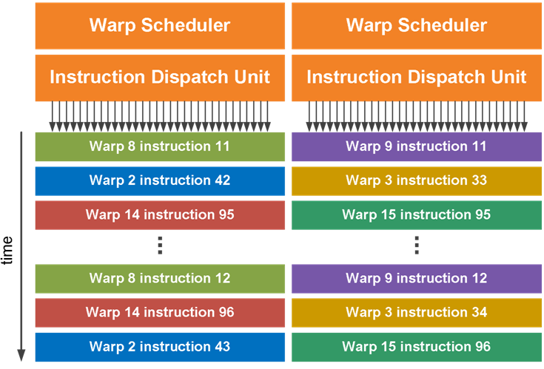
Quick Remarks
ILP support: relatively limited
GPU architecture is pipelined
At each clock cycle one instruction can be retired
Fermi has no out-of-order execution smarts
To the best of my knowledge
There is no prefetching
There is no speculative execution

Slide 40
Example: Fermi Related
Scheduler works at 607 MHz
Functional units work at 1215MHz
Question:
What is the peak flop rate of GTX480?
15 SMs * 32 SPs * 1215 * 2 (Fused Multiplied Add) = 1166400 Mflops
That is, 1.166 Tflops, single precision

Slide 41
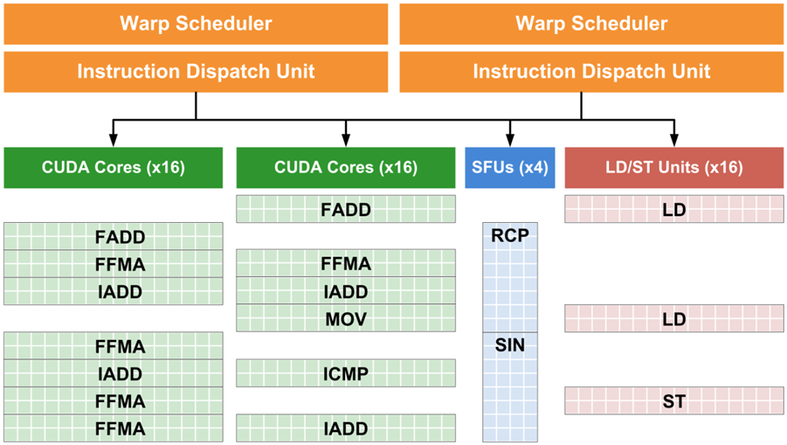
Fermi Specifics
As shown in picture, at no time can we see more than 2 warps being dispatched for execution during a cycle
Note that at any given time we might have more than two functional units working though (which is actually very good, device kept busy)
Present
T i m e
Past
Notes:
Because there are 2 schedulers: at most 2 instructions are dispatched for execution in a cycle.
But you can have more of them being executed at any given time! Indeed, an SFU for example needs 4 cycles to complete. Other warps that do not require them can be executing on other FUs (ALU, FPU, LDST)

Slide 42
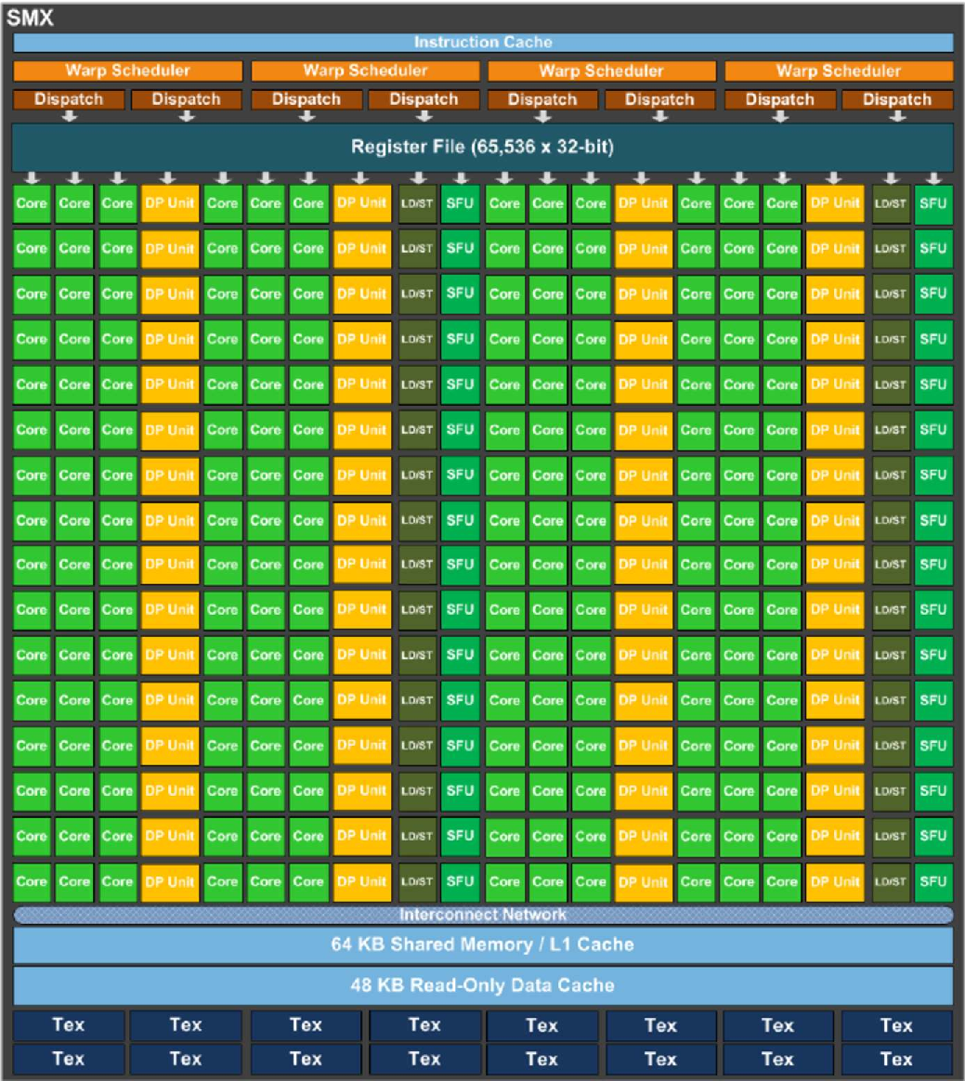
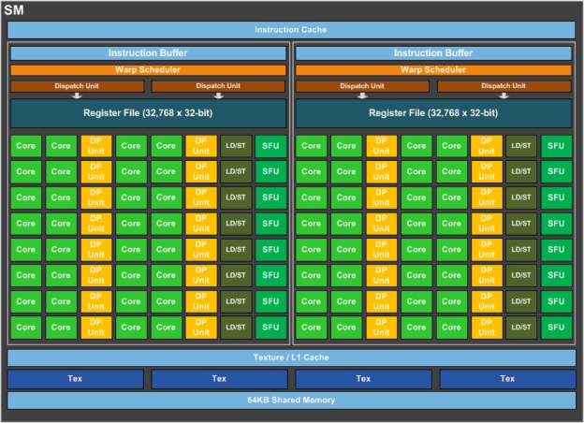
More Recent SM Generations
Volta SM
Maxwell SMX
Pascal SM
Motivated by AI & Machine Learning
Notes:
Pascal architecture indicates a move to a simpler datapath that requires less die area and lower power requirements.
But performance was not affected: smarter schedulers!
For example, Pascal can issue 32-bit operations (double precision) in a cycle.

Slide 43
What you can do with one SM (of the many you have on 1 GPU)

Slide 44
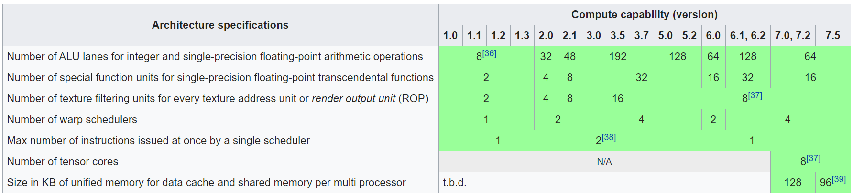
SM Architecture Specifications
Fermi
Kepler
Maxwell
Pascal
Volta
Turing
[Wikipedia]→
Notes:
Note: Volta will move back to 4 schedulers per SM
Pascal: compute capability 6.0

Slide 45
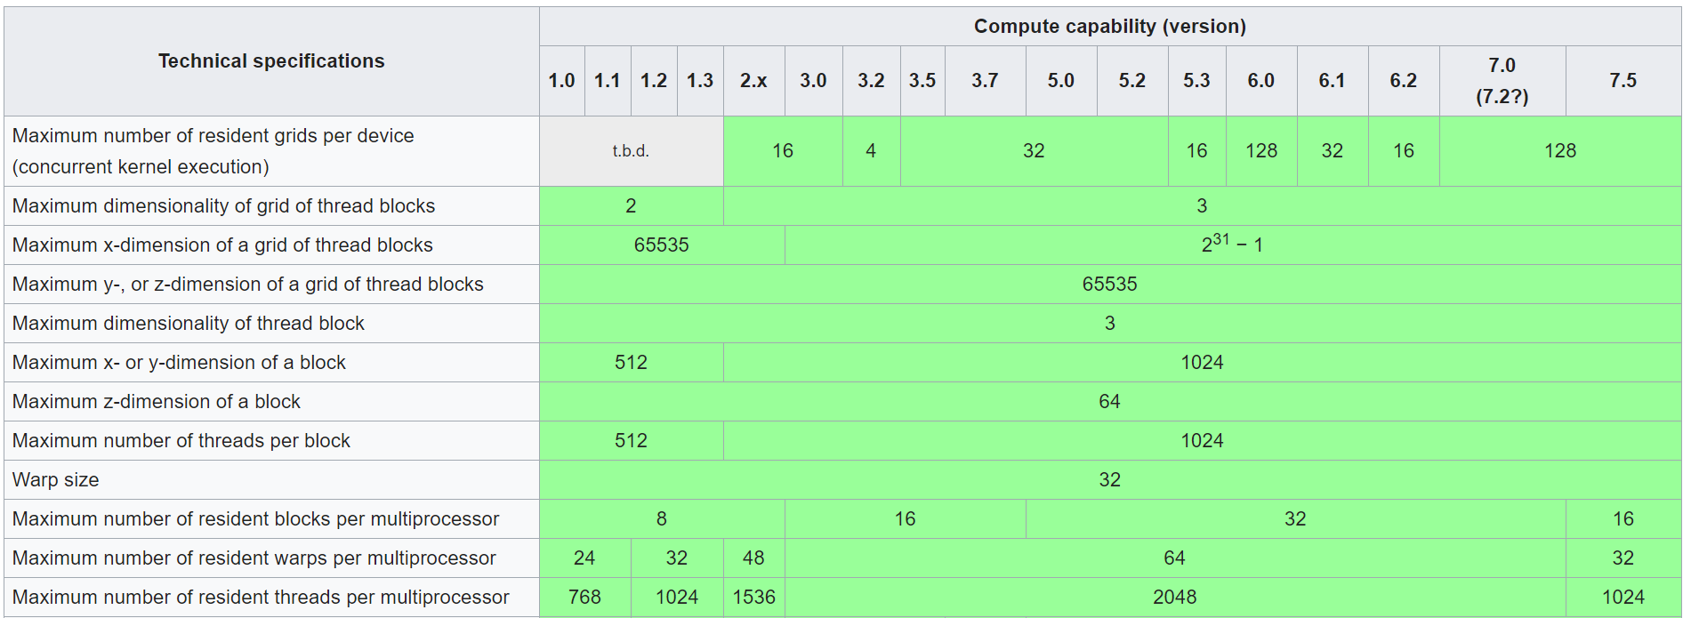
Technical Specifications and Features
[Wikipedia]→
Notes:
Recall: compute capability is an expression of the hardware generation.

Slide 46
Organizing Threads into Warps
Thread IDs within a warp are consecutive and increasing
Related to the 1D projection from thread index to thread ID
Recall: in multidimensional blocks, the x thread index runs fastest, then y, then z
Threads with IDs (0...31) combine into warp 0, threads (32…63) into warp 1, etc.
Partitioning of threads into warps is always the same
You can use this in control flow
Warp size has always been 32 and is unlikely to change soon
While you can rely on ordering among threads, DO NOT rely on any ordering among warps
Warp scheduling is not under user control in CUDA
Notes:
In other words, thread with ID 67 will always be in warp 2. You can use that!
(What you probably will use is that thread IDs 66 and 67 are in the same warp)
But you cannot count on, say, warp 1 to be always scheduled before warp 2!

Slide 47
Threads are Organized & Executed as Warps
Each thread block split into one or more warps
If thread block size is not multiple of warp size, unused lanes go wasted
Example: block w/ 50 threads – 64 lanes, of which last 14 lanes go wasted
The hardware schedules each warp independently
Warps within a thread block execute independently
Warp of 32 threads
Block of 128 threads
Warp of 32 threads
Warp of 32 threads
Warp of 32 threads
NVIDIA [J. Balfour]→
Notes:
A block of 128 threads, color-coded in 4 colors (4 warps).
The warps are scheduled as a unit.
It is not required to have the block size a multiple of 32, but it’s a good idea!

Slide 48
Why many warps in flight is a good thing
An SM can switch between warps with almost no overhead
Warps with instruction whose inputs are ready are eligible to execute, and will be considered when scheduling
When a warp is selected for execution, all [active] threads execute the same instruction in lockstep fashion
(pre-Volta; not anymore for Volta & Turing)
W₄
W_{n}
Executing W_{n}
W₃
Waiting for data
W₂
W₁
Ready to execute
[NVIDIA, J. Balfour]→
Notes:
Why is it good to have many warps?
If you need a memory transaction, these take hundreds of cycles.
You need eligible warps to be executed while others wait for data (white areas)
Hiding memory latency with useful computation
Note: more warps not always better!

Slide 49
Execution Configuration, revisiting the concept
Prefer thread block sizes that result in mostly full warps
Bad: kernel<<<N, 1>>> ( ... )
Okay: kernel<<<(N+31) / 32, 32>>>( ... )
Better: kernel<<<(N+127) / 128, 128>>>( ... )
Many threads per block provide SM with many warps to switch between
This is how the GPU hides memory access latency
Resource like amount of ShMem & size of RegFile may constrain number of threads per block
NVIDIA [J. Balfour]→
Notes:
Do not launch N blocks each with 1 thread!
OK, but not great, to have 32 threads in 1 block (that’s only 1 warp)
Best: Use 128, 256 threads/block
But maximum number of threads in a block is limited by shared memory (for example – see later). That would limit the number of blocks resident on an SM. This may reduce occupancy.
The moral of the story: algorithms may need to be changed for parallel computing, maybe to something that would be ridiculous to do on a sequential architecture!
We will see this on matrix multiplication with shared memory

Slide 50
Scheduling: Summing It Up…
When host invokes a kernel grid, the blocks of the grid are enumerated and distributed to SMs with available execution capacity
Number of resident blocks on one SM
Up to 8 blocks (on Fermi)
Up to 16 on Kepler & Turing
Up to 32 on Maxwell, Pascal, and Volta
When a block of threads is executed on an SM, its threads are grouped in warps. The SM manages several warps at the same time
Up to 48 warps can be managed by an SM on Fermi
Up to 64 warps can be managed on Kepler, Maxwell, Pascal, and Volta
Up to 32 warps can be managed on Turing
When a thread block finishes, a new block is launched on the vacated SM

Slide 51
Thread Divergence
[pre-Volta]
Notes:
New topic related to execution scheduling

Slide 52
Thread divergence issues
Consider the following code:
__global__ void odd_even(int n, int* x)
{
int i = threadIdx.x + blockDim.x * blockIdx.x;
if( (i & 0x01) == 0 )
{
x[i] = x[i] + 1;
}
else
{
x[i] = x[i] + 2;
}
}
Half the threads (even i) in the warp execute the if clause, the other half (odd i) the else clause
NVIDIA [J. Balfour]→
Notes:
0x01: all bits are 0 except the very least significant one.
When i is even, the “if” gets hit; when i is odd, the “else” side gets hit
Neighboring threads do different things → the threads inside a warp diverge
This requires two cycles: it’s as if the number of instructions was doubled

Slide 53
Thread Divergence in “if-then-else”
Handling of an if-then-else construct in CUDA
First, a subset of threads of the warp execute one branch
Execution moves forward for these threads in lockstep fashion
Next, the rest of the threads in the warp execute the other branch
Execution moves forward for these threads in lockstep fashion
After the if-then-else statement all threads of the warp move on in lockstep fashion

Slide 54
Thread divergence issues
The system automatically handles control flow divergence, conditions in which threads within a warp execute different paths through a kernel
Often, this requires that the hardware execute multiple paths through a kernel for a warp
For example, both the if clause and the corresponding else clause
NVIDIA [J. Balfour]→
Notes:
A switch statement may have similar effects.
This results in longer times required to advance the warp

Slide 55
Thread divergence issues
__global__ void kv(int* x, int* y)
{
int i = threadIdx.x + blockDim.x * blockIdx.x;
int t;
bool b = f(x[i]);
if( b )
{ // g(x)
t = g(x[i]);
}
else
{ // h(x)
t = h(x[i]));
}
y[i] = t;
}
NVIDIA [J. Balfour]→
Notes:
Some threads in the warp follow the if branch. The rest are idle.
Some threads in the warp follow the else branch. The rest are idle.

Slide 56
Thread divergence issues
Nested branches are handled similarly
Deeper nesting results in more threads being temporarily disabled
In general, one does not need to consider divergence when reasoning about the correctness of a program*
Certain code constructs, such as those involving schemes in which threads within a warp spin-wait on a lock, can cause deadlock
In general, one does need to consider divergence when reasoning about the performance of a program
NVIDIA calls execution model SIMT (Single Instruction Multiple Threads) to differentiate from actual SIMD where threads really are in lockstep
NVIDIA [J. Balfour]→
Notes:
You do not need to understand this to write code that runs correctly. The system handles this.
You need to worry about this for code that is performant.
Thread divergence is why NVIDIA calls their execution model SIMT. Subtle difference from SIMD: SIMT is SIMD for as long as the threads in a warp execute in lockstep mode; slightly different when threads diverge.

Slide 57
Performance of Divergent Code (1/2)
Performance decreases with degree of divergence in warps
Here’s an extreme example…
__global__ void dv(int* x)
{
int i = threadIdx.x + blockDim.x * blockIdx.x;
switch (i % 32)
{
case 0 : x[i] = a(x[i]);
break;
case 1 : x[i] = b(x[i]);
break;
...
case 31: x[i] = v(x[i]);
break;
}
}
NVIDIA [J. Balfour]→
Notes:
There are different levels of thread divergence.
This extreme example requires a minimum of 32 cycles.

Slide 58
Performance of Divergent Code (2/2)
Compiler and hardware can detect when all threads in a warp branch in the same direction
Example: all take the if clause, or all take the else clause
The hardware is optimized to handle these cases without loss of performance
if (threadIdx.x / WARP_SIZE >= 2) { }
Creates two different control paths for threads in a block
Branch granularity is a whole multiple of warp size; all threads in any warp follow the same path. No warp divergence…
The compiler can also compile short conditional clauses to use predicates (bits that conditionally convert instructions into null ops)
Avoids some branch divergence overheads and is more efficient
Often acceptable performance with short conditional clauses
NVIDIA [J. Balfour]→
Notes:
Note:
the presence of an if/else statement in a kernel function is not a problem by itself.
thread divergence concerns only divergence of threads within a warp!
Even for threads diverging inside a warp, in special situations (short sequences), the compiler can modify the code to remove thread divergence: all threads in a warp execute the same instructions, but some of those are replaced by the compiler with no-ops which do not write memory or registers. → acceptable penalty hit

Slide 59
See forum post here:
https://devtalk.nvidia.com/default/topic/1031723/cuda-programming-and-performance/warp-divergence-triggered-by-for-loop/post/5249002/?offset=3#5249003

Slide 60
Thread divergence, VOLTA and TURING
Volta GV100 is the first GPU to support independent thread scheduling, which enables finer-grain synchronization and cooperation between parallel threads in a program
Consequence
Greater flexibility in thread cooperation, leading to higher efficiency for fine-grained parallel algorithms

Slide 61
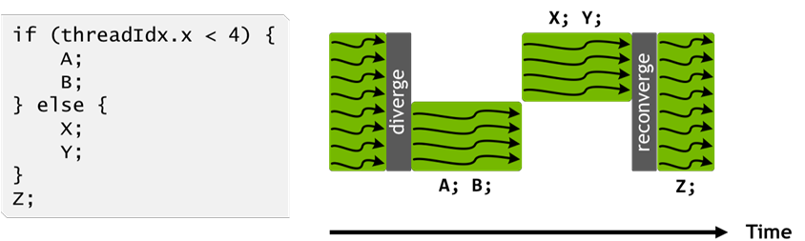
Handling thread divergence, pre-Volta (Pascal and before)
Pascal and earlier NVIDIA GPUs execute groups of 32 threads (warps) in SIMT
The Pascal warp uses a single program counter shared amongst all 32 threads, combined with an active mask that specifies which threads of the warp are active at any given time
Loss of concurrency means that threads from the same warp in divergent regions or different states of execution cannot signal each other or exchange data
This is because some threads just sit and do nothing, they’re not active
[NVIDIA]$→$

Slide 62
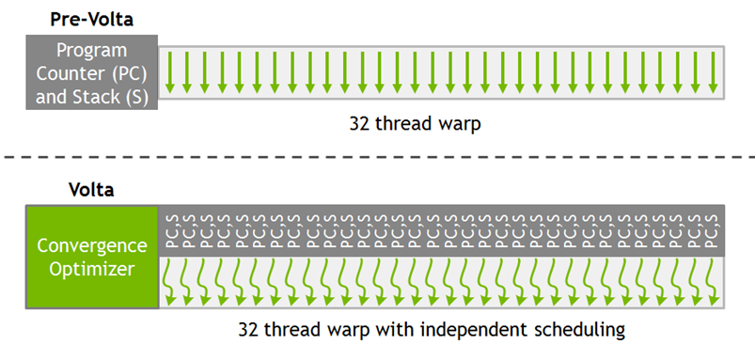
SIMT Warp Execution Model of Pascal and Earlier GPUs
Volta enables equal concurrency between all threads, regardless of warp
Volta maintains execution state (PC and S) per thread, see pic at the right
Pascal and before: one PC and S per warp
PC: program counter
S: call stack
[NVIDIA]$→$

Slide 63
The schedule optimizer
To maximize parallel efficiency, Volta includes a schedule optimizer which determines how to group active threads from the same warp together into SIMT units
Threads can now diverge and re-converge at sub-warp granularity
While the scheduler supports independent execution of threads, it optimizes non-synchronizing code to maintain as much convergence as possible
The “convergence optimizer” will still group together threads which are executing the same code and run them in parallel
Flow control simpler, might lead to better efficiency?

Slide 64
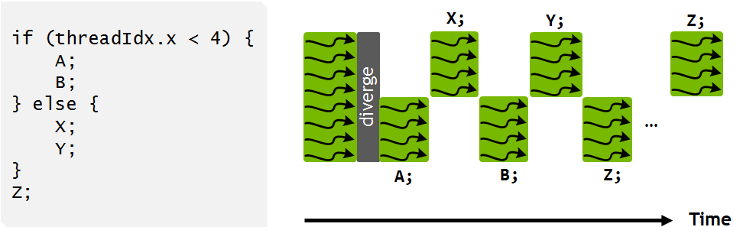
Handling thread divergence, Volta and Turing
Instructions from the if and else branches can now be interleaved in time, as shown in the pic.
NOTE: what’s shown in the pic is one possibility. How the scheduling takes place depends on the code being executed and be different than what shown in the pic
IMPORTANT: execution is still SIMT – at any given clock cycle, the same instruction is executed for all active threads in a warp just as before Volta
Why bother with understanding this?
Ability to independently schedule threads within a warp makes it possible to implement complex, fine-grained algorithms and data structures in a more natural way
[NVIDIA]$→$

Slide 65
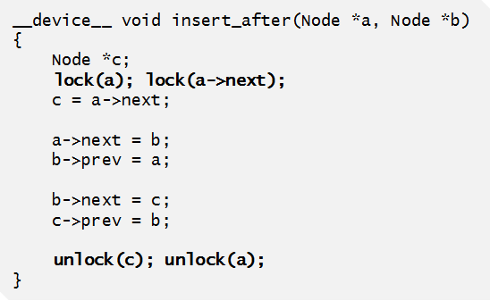
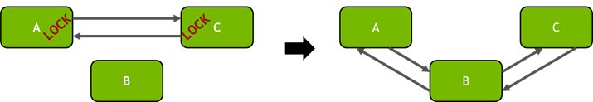
Example: Volta thread scheduling helps algorithm implementation
“Starvation-free algorithm” – a parallel algorithm that works on the presumption that a thread that participates in the implementation of the algorithm cannot be starved
NVIDIA GPUs prior to Volta: didn’t support starvation avoidance
Indeed, one or more threads may repeatedly acquire and release a mutex while starving another thread from ever successfully acquiring the mutex
Example at right shows how Volta independent thread scheduling implements a starvation-free algorithm
Inserting nodes into a doubly linked list in a multithreaded application
Per-node locks are acquired (left) before inserting node B into the list (right).
[NVIDIA]$→$
Notes:
Independent thread scheduling in Volta ensures that even if a thread T0 currently holds the lock for node A, another thread T1 in the same warp can successfully wait for the lock to become available without impeding the progress of thread T0. Note, however, that because active threads in a warp execute together, threads spinning on a lock may degrade the performance of the thread holding the lock.
It is also important to note that the use of a per-node lock in the above example is critical for performance on the GPU. Traditional doubly-linked list implementations may use a coarse- grained lock that provides exclusive access to the entire structure, rather than separately protecting individual nodes. This approach typically leads to poor performance in applications with many threads—Volta may have up to 163,840 concurrent threads—caused by extremely high contention for the lock. By using a fine-grained lock on each node, the average per-node contention in large lists will usually be low except under certain pathological node insertion patterns.

Slide 66
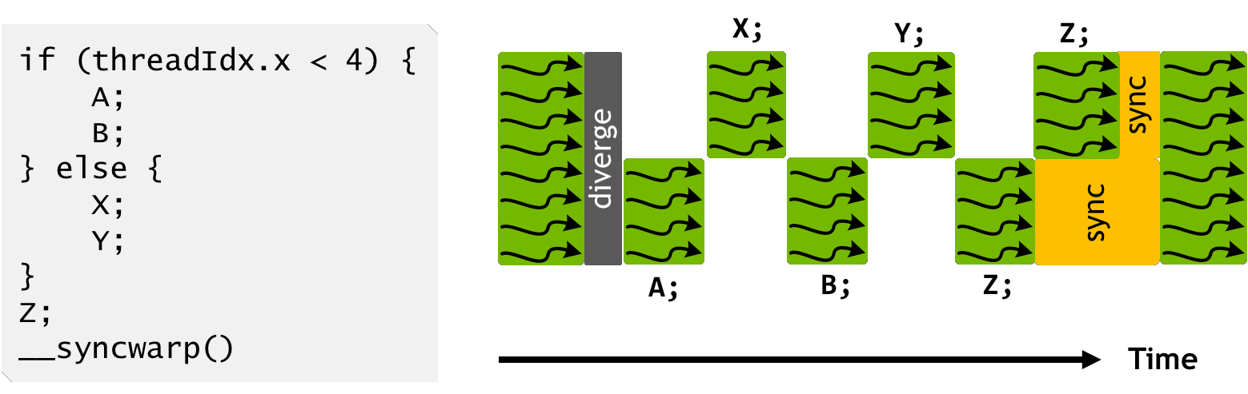
Handling thread divergence, Volta and Turing
Note that instruction Z is not executed by the same warp threads at the same time
DN: In the “white blocks”, it might be that the scheduler executes other threads? Not clear
Call CUDA 9 warp synchronization function syncwarp() to force reconvergence (lower pic)
The divergent portions of the warp might not execute Z together, but all execution pathways from threads within a warp will complete before any thread reaches the statement after the syncwarp()
Placing the call to syncwarp() before the execution of Z would force reconvergence before executing Z, potentially enabling greater SIMT efficiency if the developer knows that this is safe for their application
[NVIDIA]$→$

